Slide 1
Social Media
The world's largest referral platform in history

Slide 2
Social Business
Sales
2015
$ 14 billion
2014
$ 9 billion
2013
2012
$ 5 billion
2012 to 2015
(in US dollars)
$ 3 billion

Slide 3
This is what socializing used to look like OFFLINE

Slide 4
Now, this is what socializing looks like OFFLINE

Slide 5
Effects of Social Media
Automatically help you find friends who have lost contact for a long time
Expand your interpersonal life and naturally get connected with your friends
Diversify sharing and interaction
Easy to build up personal style and personal image
Increase name list and automatically warm-up for better follow-up
Personal

Slide 6
Avoid misunderstanding and misuse of social media
Quality of friends may be more effective than the number!
Don’t just befriend with people within Market America, make friends with people outside of this circle!
Quality interaction matter, rather than meaningless gossip.
You can’t fake it in networking! Be yourself!
It’s only a medium so it can’t replace meetings and all the necessary things.

Slide 7
How should we do this?
4.Choose the object
3.Maintain image
5.Deep interaction
2.Choose platform
6.Take action
1.Identify the purpose
7.Follow up and reach the goal

Slide 8
Select several suitable
platforms.
Operate
diligently

Slide 9
Operating image - positive and professional
Create a complete online profile
Choose a suitable profile picture
Share a beautiful lifestyle and positive thinking
Interests / expertise / hobbies | Become a contributor
Tell stories
Share what your are doing now
Be yourself and sincerely care for your friends
Operating social media

Slide 10
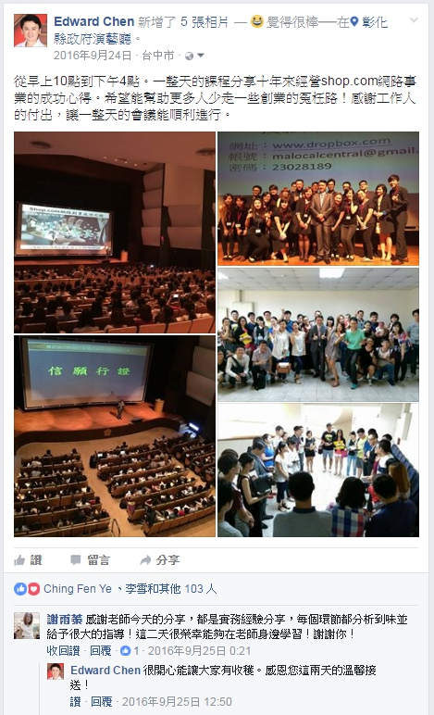
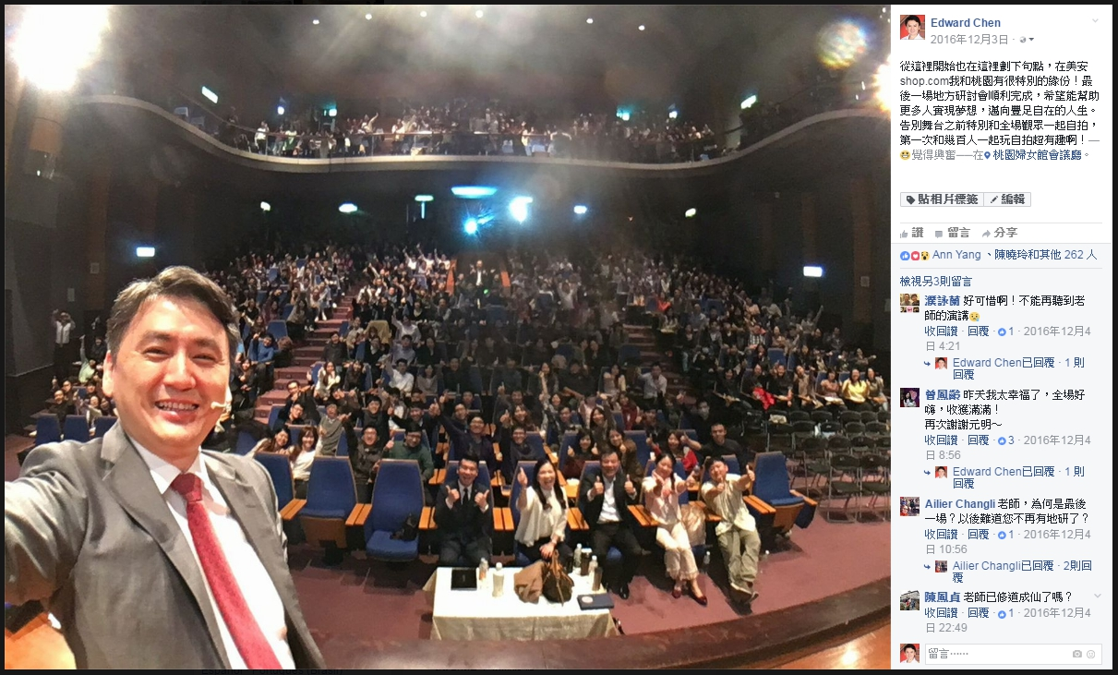
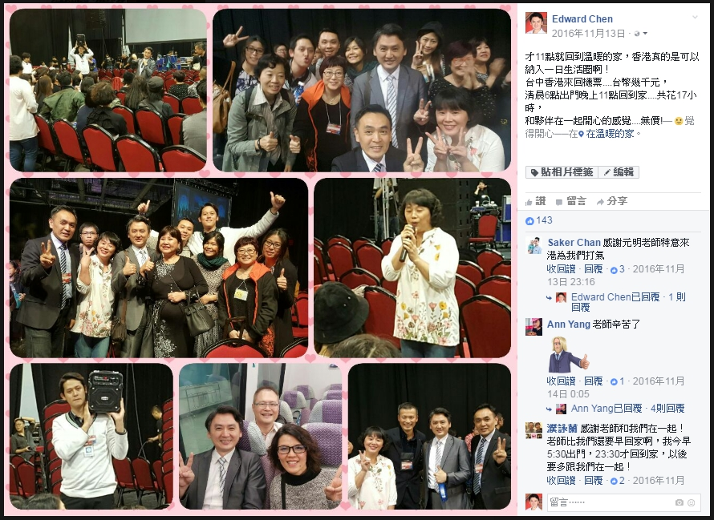
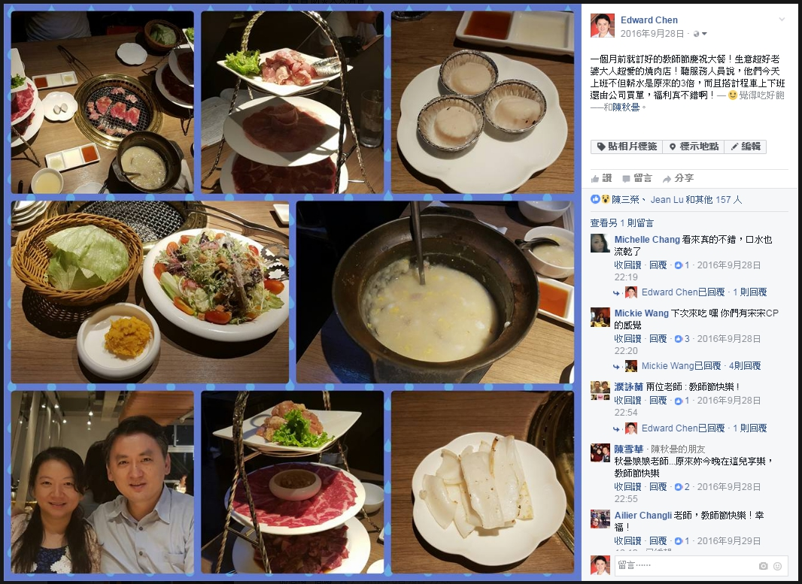
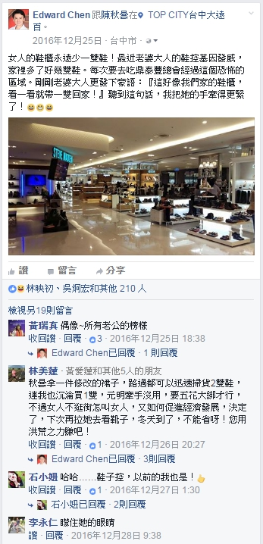
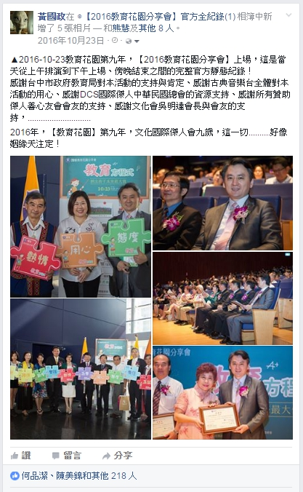

Slide 11
Choose the object and interact deeply
Positive, caring, helpful, responsive
Suitable for?
Ask for advice, ask for help, guess, quiz contest
Interactive posts
FORMHD
To have deeper understanding in order to garner interest and provide appropriate solution
Private is Better than Public
Public post can be viral while private message allows in-depth interaction

Slide 12
20%
Business
Social media is about the relationship between people. If your posts are related to business, you are not connecting with people, and your friends may stop keeping in touch.
80%
Remember, you are marketing yourself.
You are not a single brand or company or an organisation. You are just you.
Personal

Slide 13
We are in a sliding world

Slide 14
Almost all posts should have one
Picture
Video

Slide 15
Social media sharing
When sharing, follow the 10-3-1 rule
Share 10 entertaining /interesting /inspiring posts
Share 3 specific industry news
Share 1 company product post.
Reiterate: This rule helps you to avoid "over-selling"

Slide 16
Case Study!

Slide 17
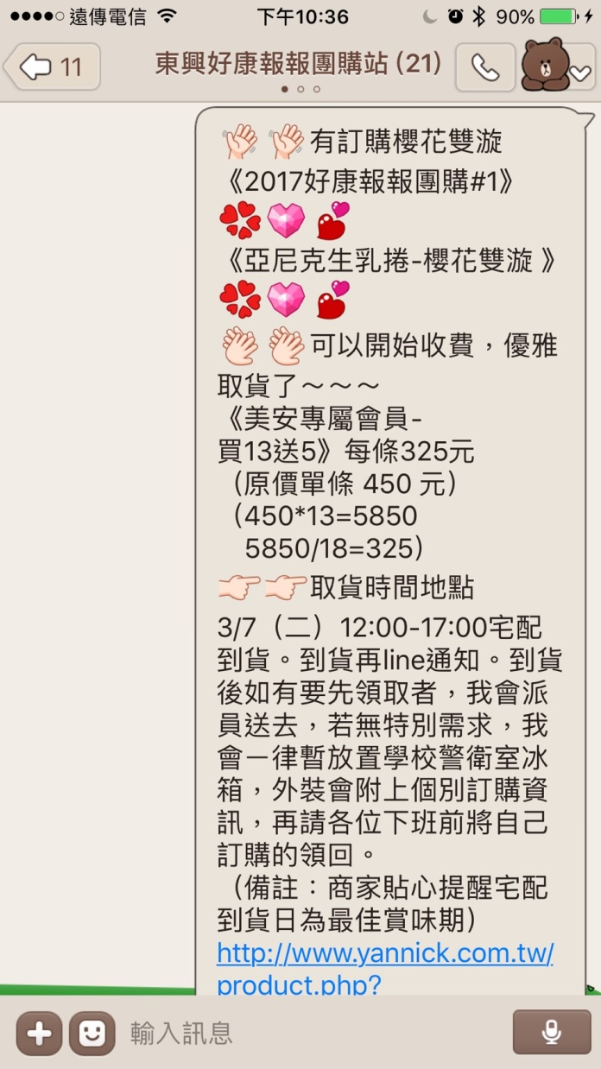
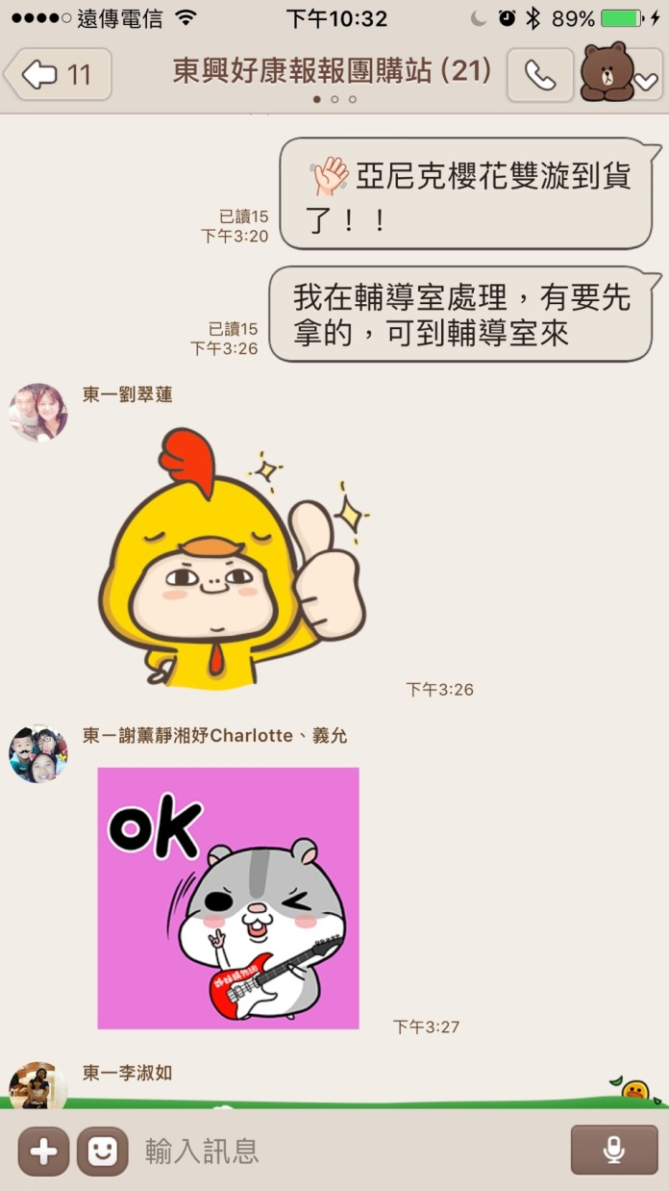

Slide 18
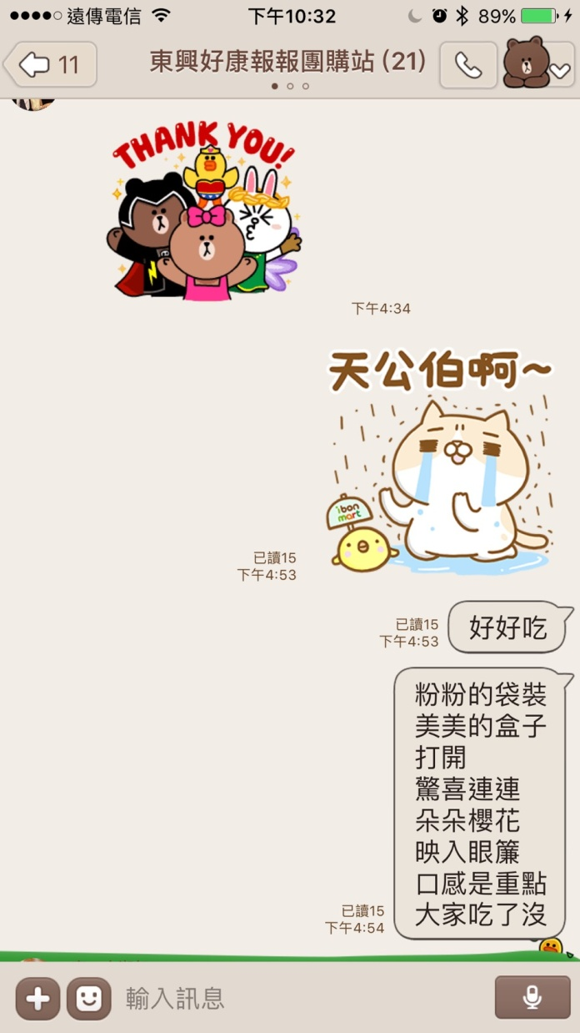
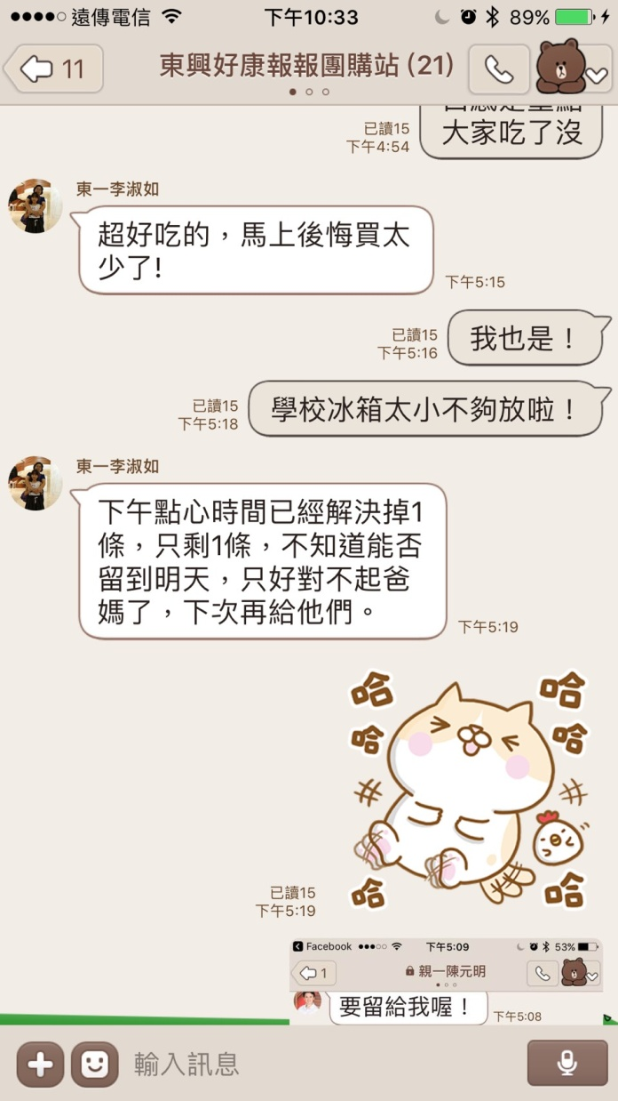
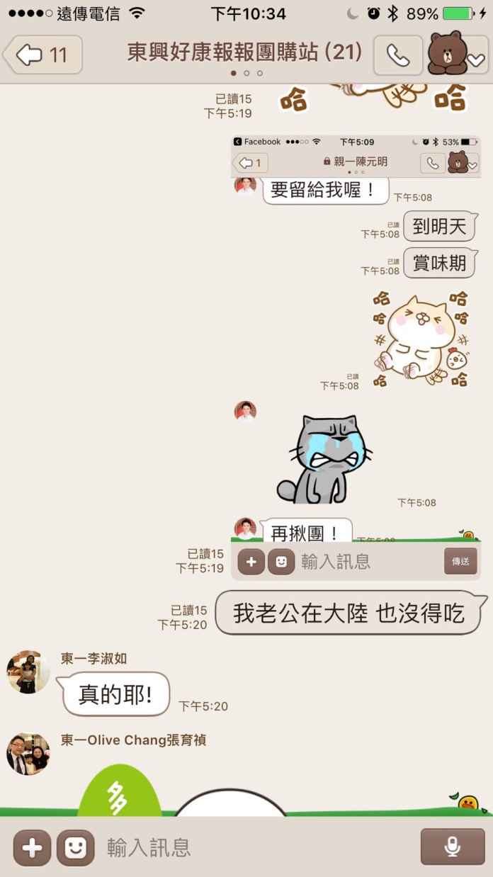
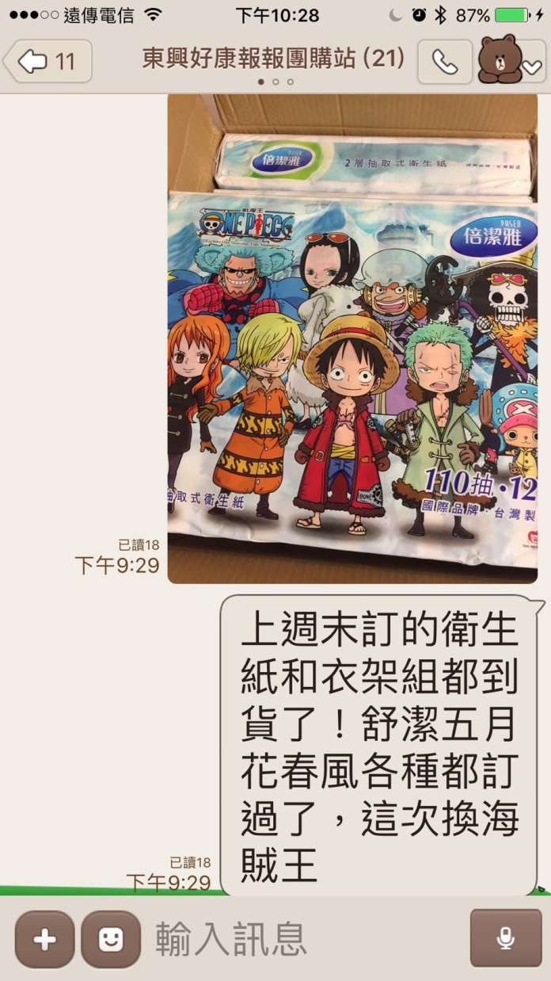

Slide 19
Important Reminders!
Group Power! You can form groups, based on your workplace or neighbourhood so it’s easy to gather group purchases, occasional group purchases. When you want to make purchase, call your colleagues, friends and neighbours! Prospect and build relationships from group purchase activities!
Regular group purchases help you to achieve shopping annuity! But remember! It is not the bigger the better, it’s better to provide order pick up at a convenient location. Share the fun of earning cashback through group purchases on Facebook. Educate those who are interested in group purchase to shop via your shop.com website. Prospect and build relationships from group purchase activities!

Slide 20
Case Study!

Slide 21
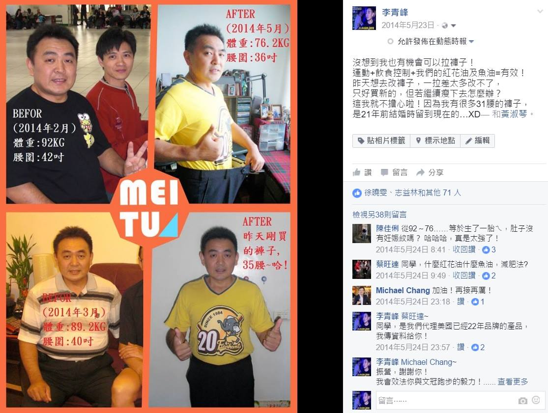

Slide 22
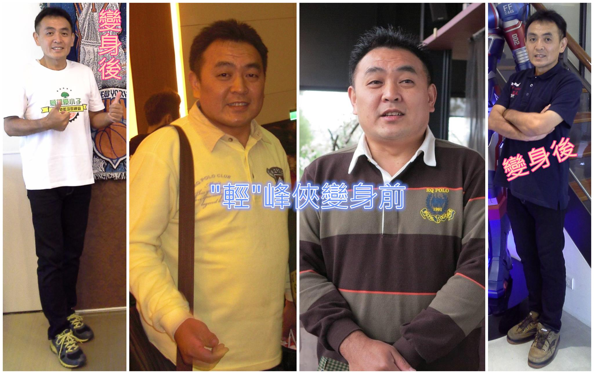

Slide 23
Self-marketing at appropriate times
to show your professional results

Slide 24
Important Reminders!
Do not directly post product photos, because it would seem too pushy. Share the benefits of using the product. There is an Internet saying: a team will tell the truth and a picture is worth a thousand words. Therefore it’s better to clearly state your claim with a picture!
When a friend shows interest in the product, ask him or her to communicate via private message, avoid talking about products directly on social media. Because testimonials of product efficacy may violate the law and too many product information make people feel like you are trying hard to selling something.

Slide 25
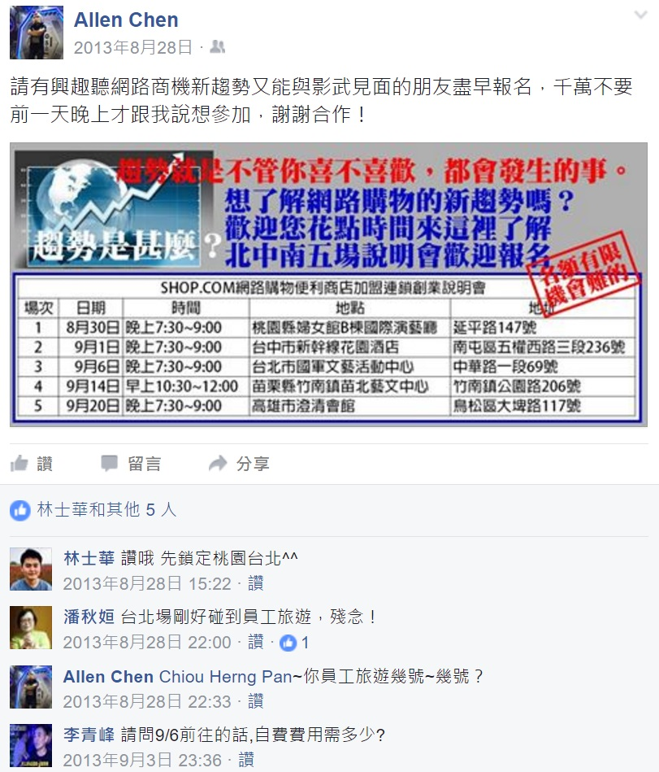
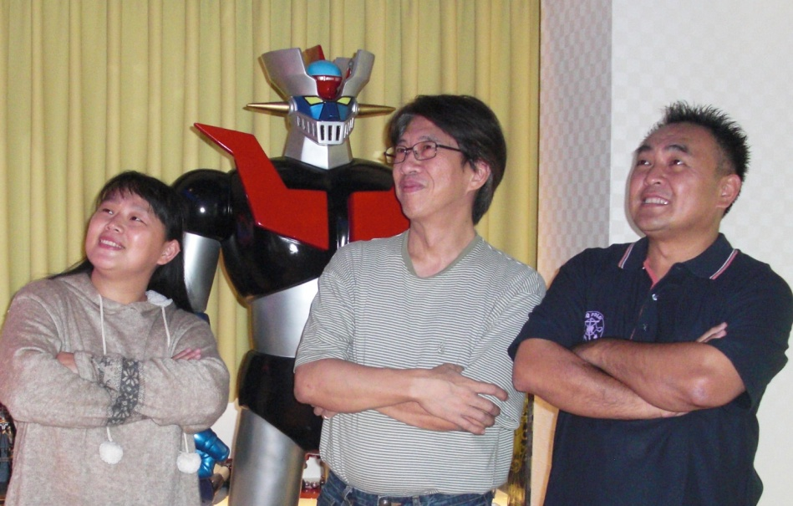
Invite timely & bravely!
A toy collector shares a positive and happy post

Slide 26
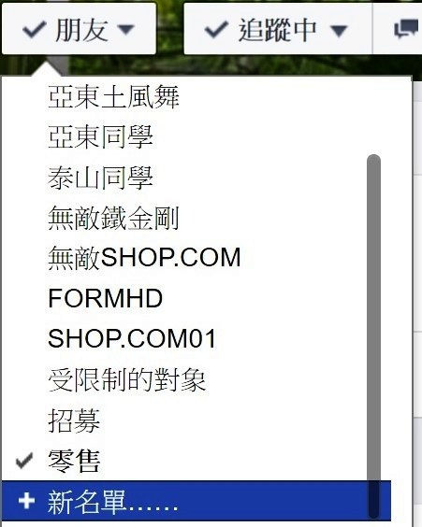
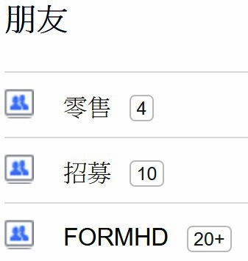
Follow up with Facebook
Use Facebook Manage Groups to set up reminders:

Slide 27
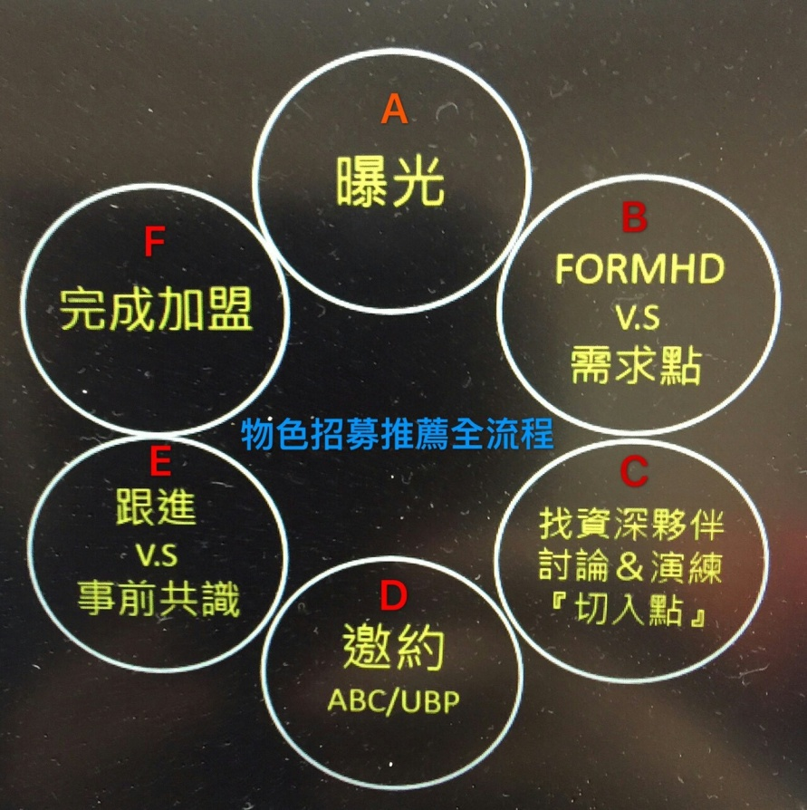
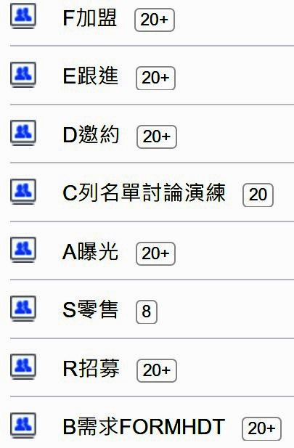
Follow up with Facebook
Latest version:

Slide 28
Social Media Workshop
Small Group Discussion
Position Yourself for Success
Group work together!
Brainstorm, Leverage, Duplicate
Self Marketing
Social Media = Socialising

Slide 29
Back to Basics!
Position Yourself for Success
Tools are tools The ultimate goal is to build the organisation scale and bring residual income.
Internet and social media are just mediums. They can’t replace meetings and all the necessary things.

Slide 30
Back to Basics!
Position Yourself for Success
Basic principle of getting along with people is always effective and always important

